Slide 1

BOX OFFICE BLUEPRINT
Data-Driven insights for a new movie studio

Slide 2

OBJECTIVES
Predict Domestic Box Office Revenue Based on Year and Studio
Estimate Foreign Gross Earnings Using Domestic Performance
Predict Total Gross Revenue (Domestic + Foreign) Using Available Features
Analyze the Trend of Domestic Revenue Over Time
Compare Studio Impact on Revenue While Controlling for Year

Slide 3

BUSINESS PROBLEM
My company now sees all the big companies creating original video content and they want to get in on the fun. And have decided to create a new movie studio, but they don’t know anything about creating movies.

Slide 4

DATA UNDERSTANDING
Cleaned and explored the dataset.
Built regression models for predicting gross revenue.
Assessed trends by studio and year.
Evaluated model performance using R squared and MSE.

Slide 5
WHAT THE DATA REVEALS
Based on our objectives:
R² Score = 0.2805 the model explains 28% of the variation in U.S. domestic gross revenue using only studio and year.
R²: 0.6994894672594614 means that about 70% of the variance in foreign gross is explained by domestic gross.
R²: 0.2712448701958182 the model explains about 27% of the variation in total_gross using just studio and year.
R²: 0.027253426852850926 means that only 2.7% of the variance in domestic gross is explained by the year of release.
R²: 0.2712448701958182 the model explains about 27% of the variation in total_gross using only studio and year.

Slide 6
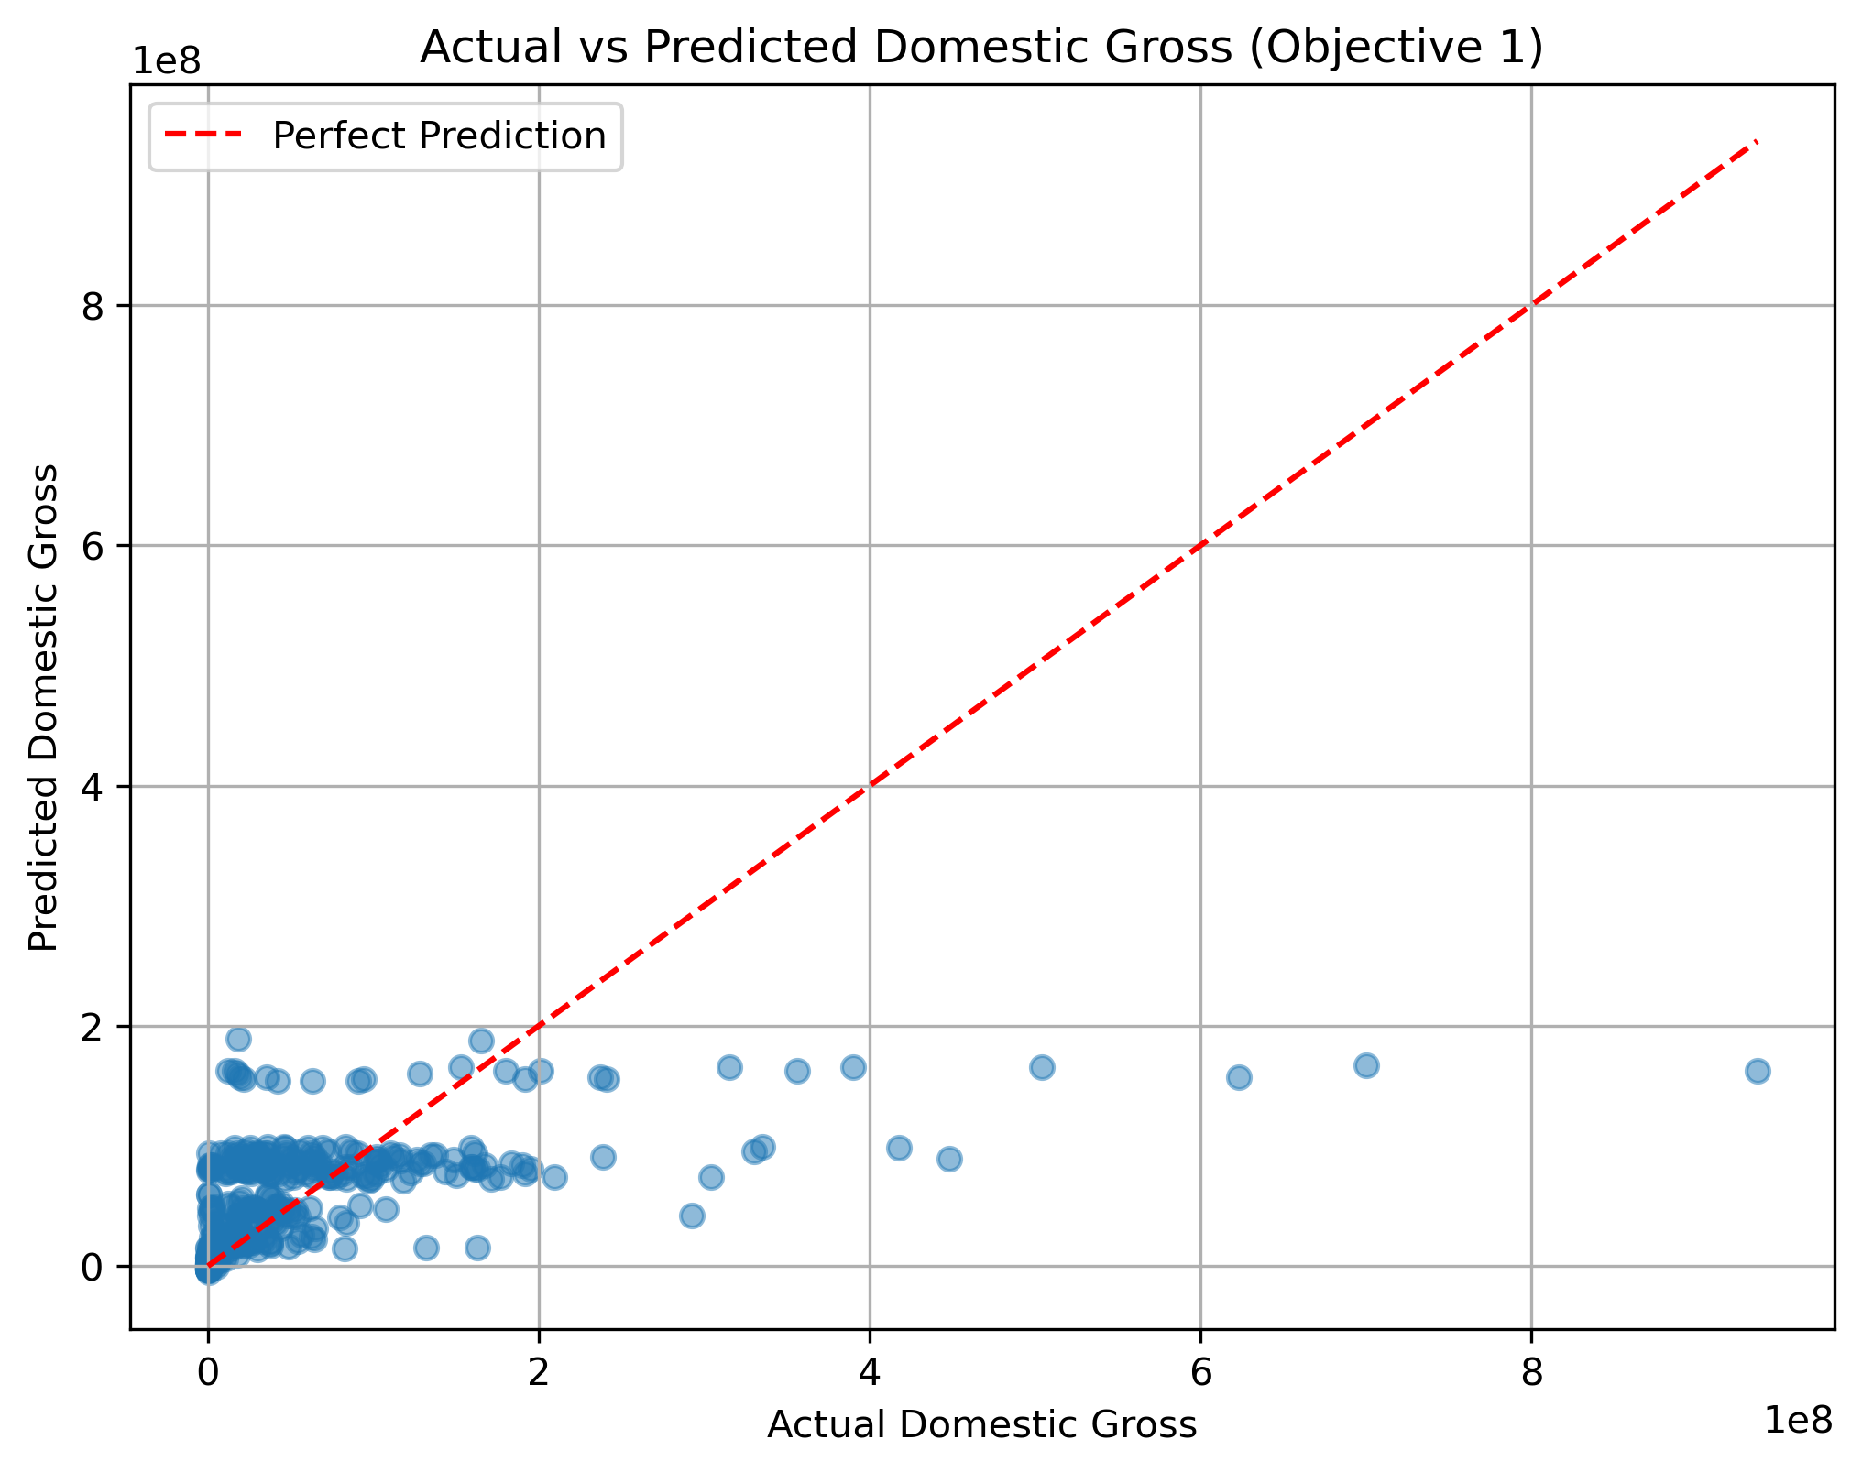
VISUALISATIONS
The goal is to estimate how much a movie earns in the U.S. based on its studio and year.

Slide 7
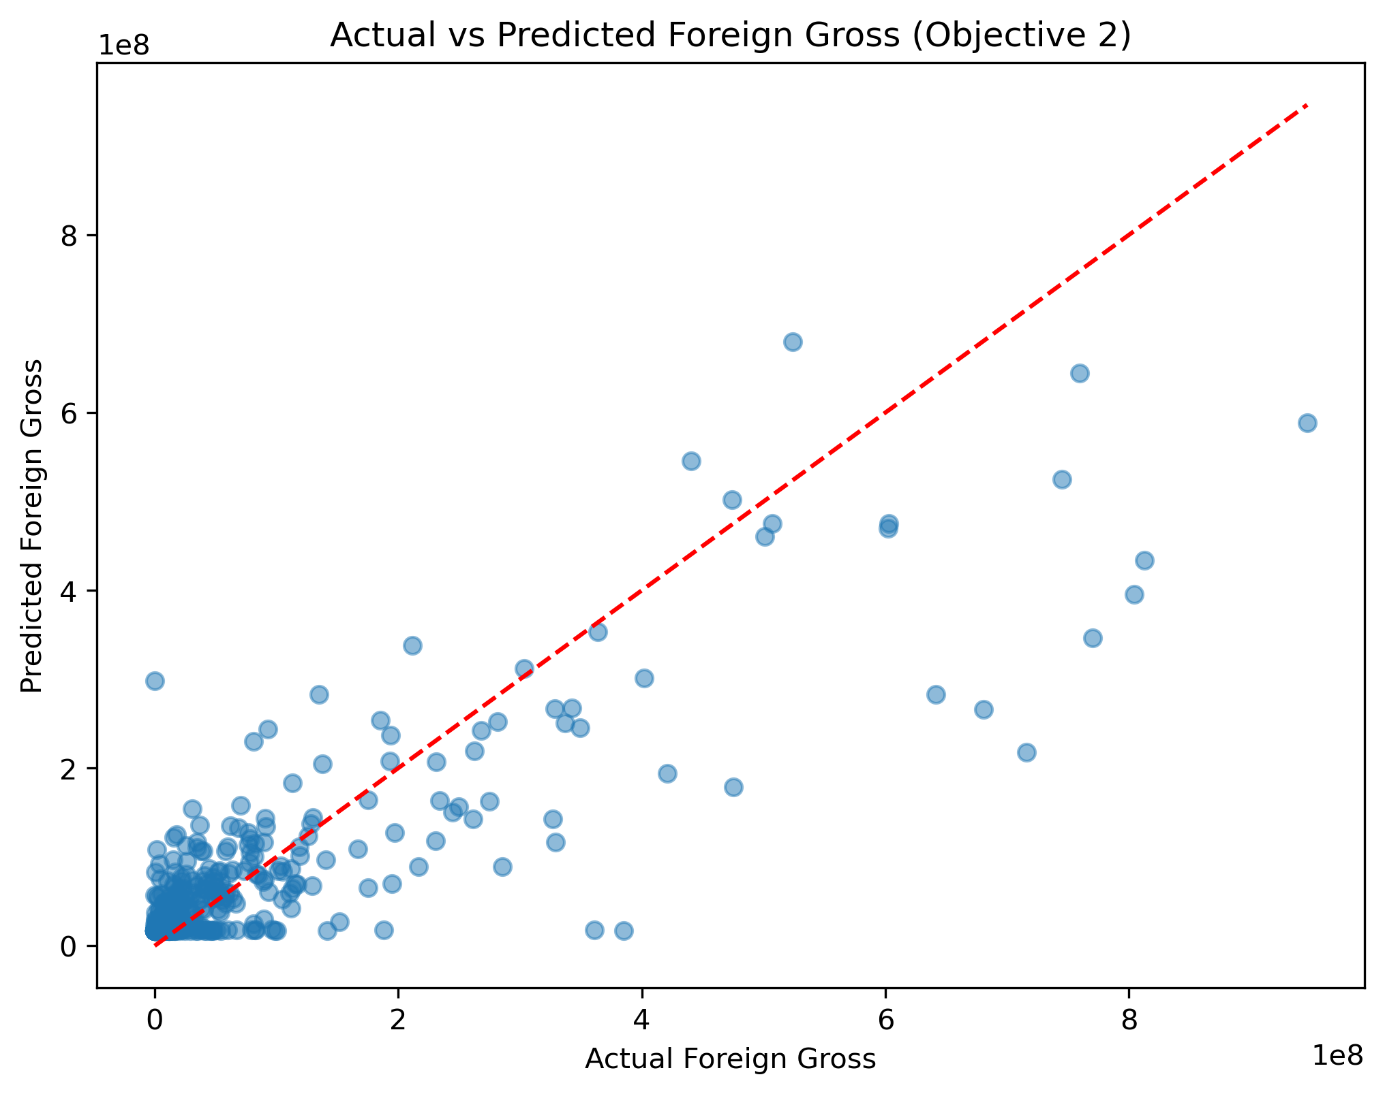
The goal is to use domestic earnings to predict international success.

Slide 8
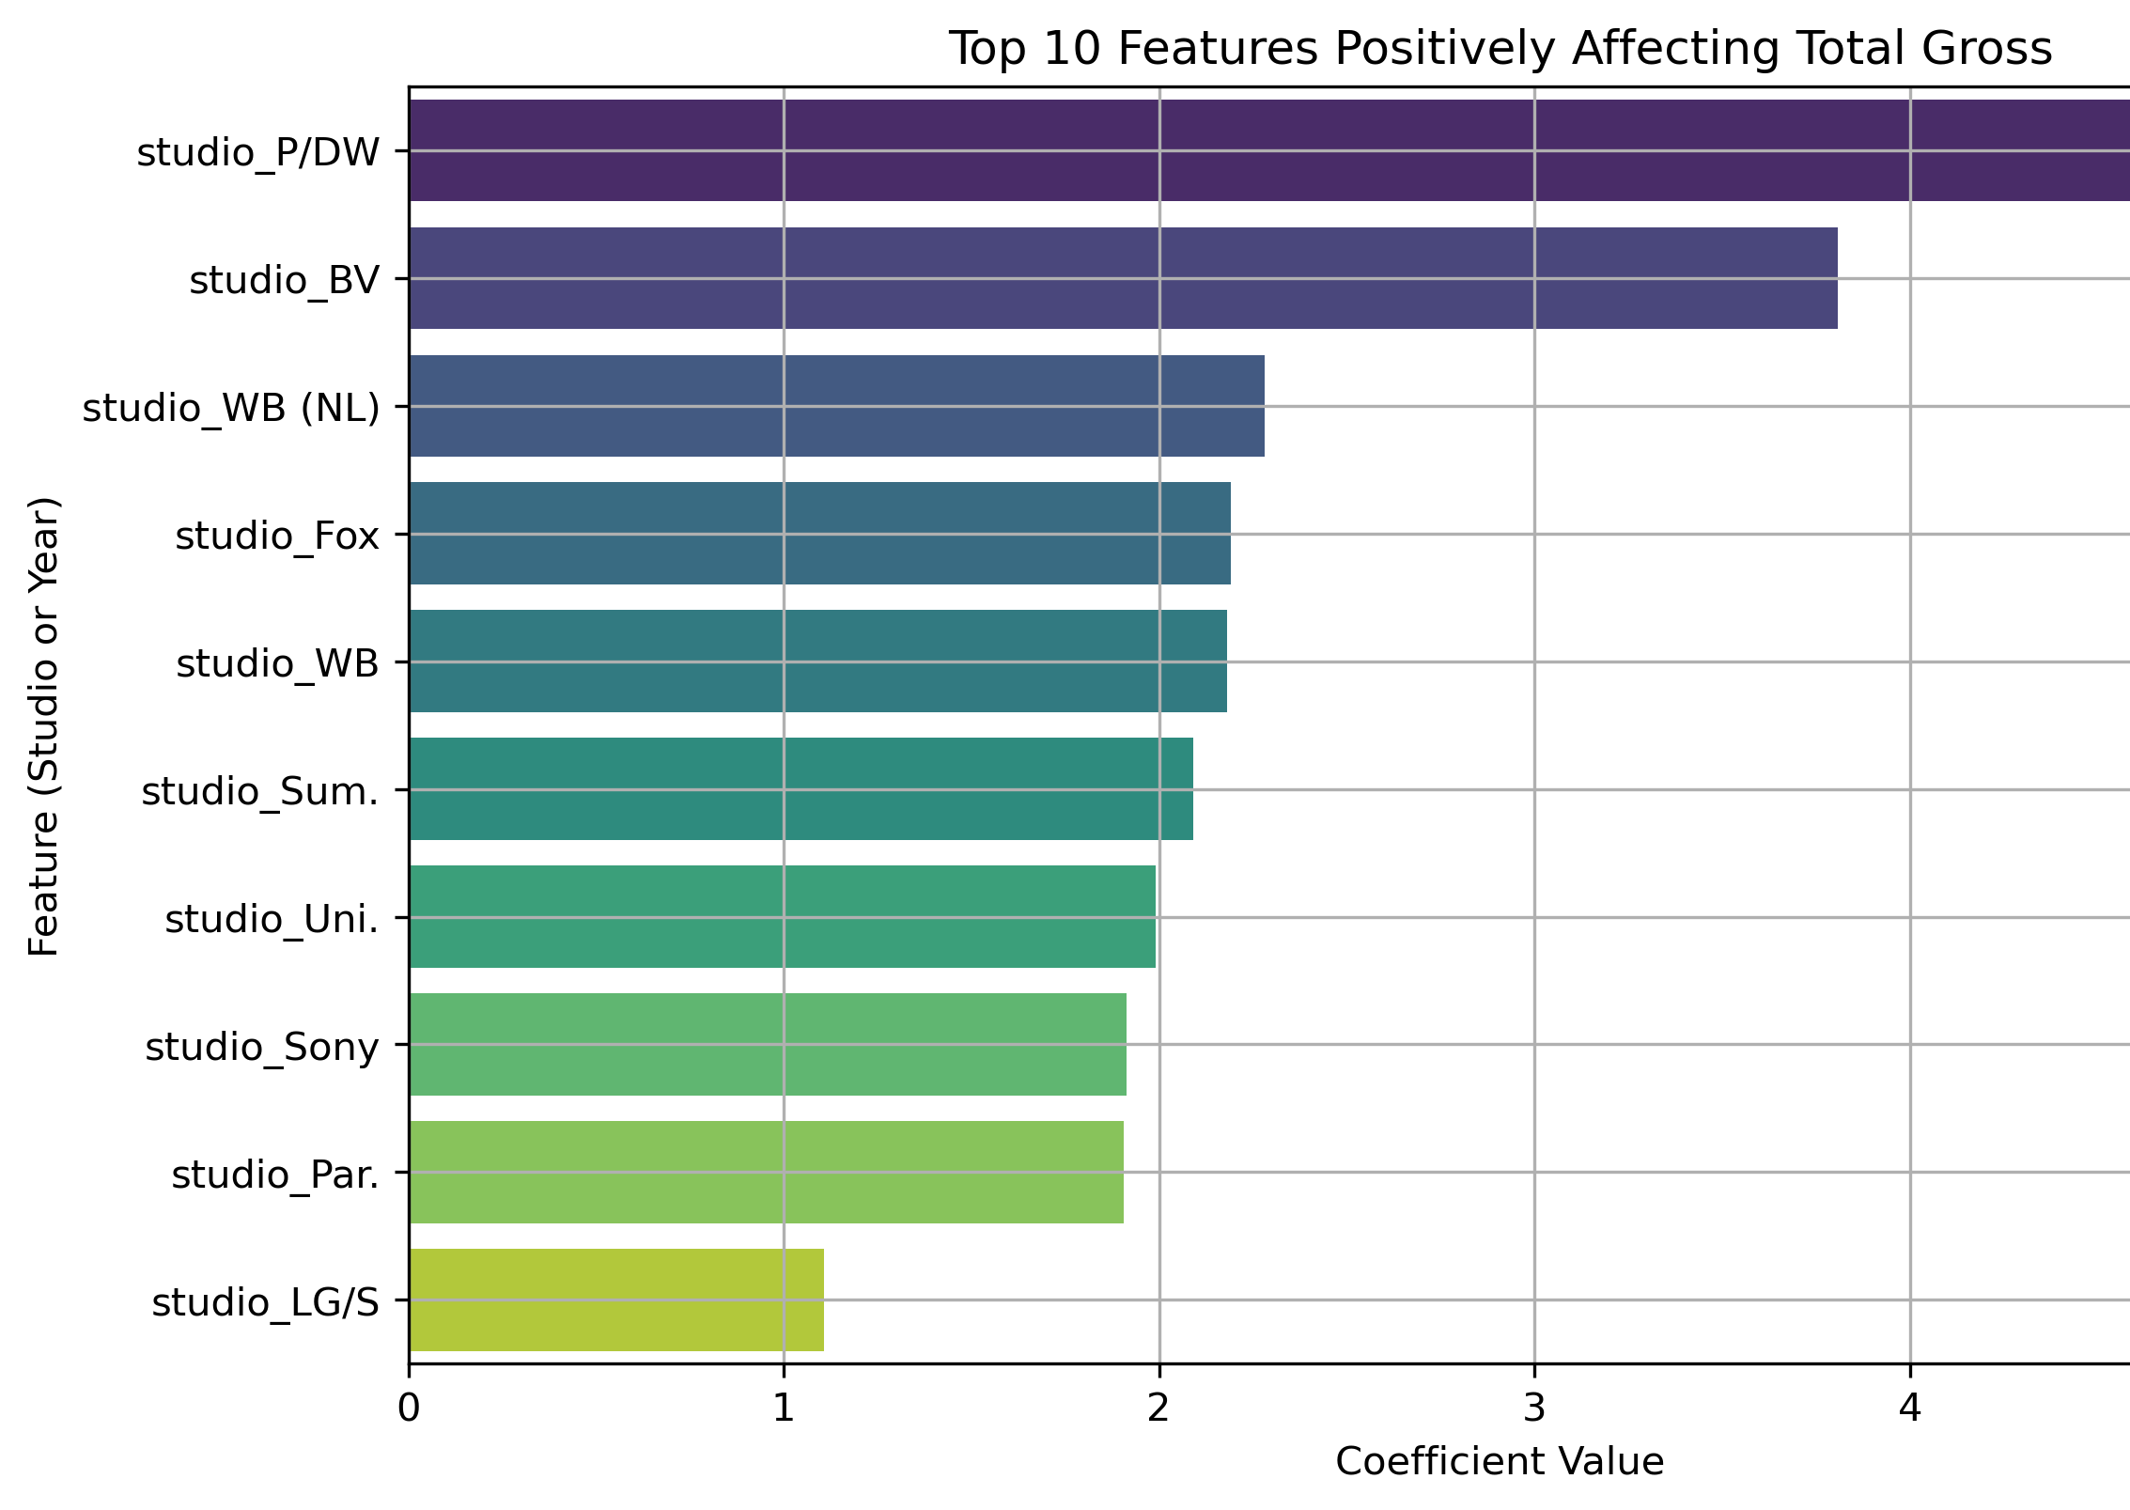
The goal is to forecast full revenue using available numeric data

Slide 9
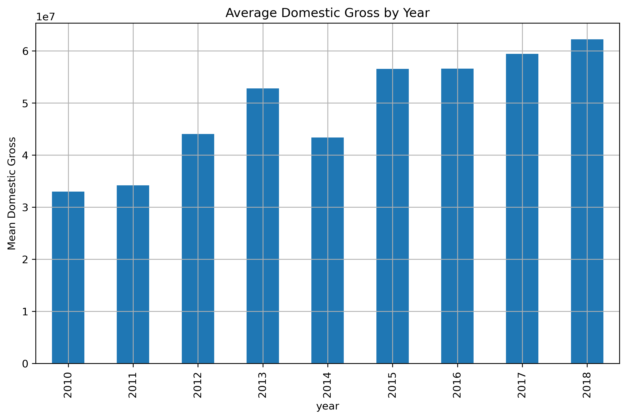
The goal is to check whether domestic revenue is increasing or decreasing across years.

Slide 10
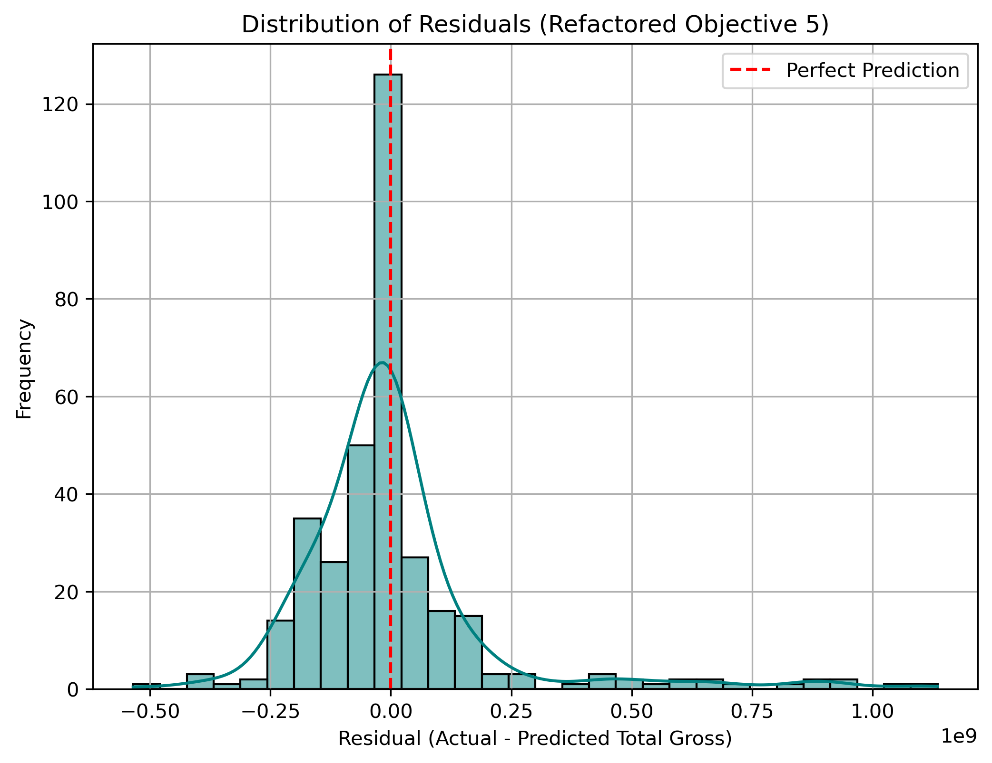
The goal is to estimate total revenue while isolating the impact of studio.

Slide 11
CONCLUSION
Our findings show that studio reputation and release year moderately predict domestic and total gross revenues, explaining around 27–28% of their variation.
Notably, domestic box office performance is a strong predictor of foreign revenue, with a model explaining nearly 70% of international earnings, a valuable insight for global forecasting.
Conversely, release year alone shows little predictive power, indicating that time trends have minimal influence without additional context.

Slide 12

MOVING FORWARD
These results highlight that while pre-release factors like studio and timing provide useful signals, more detailed data such as genre, cast, and budget is essential for stronger predictive accuracy and strategic planning.

Slide 13
Email: kigen.tuwei@student.moringaschool.com
Github: git@github.com:G-Money-Himself/Box-Office-Blueprint-Data-Driven-Insights-for-a-New-Movie-Studio.git
THANK YOU!

